Slide 1
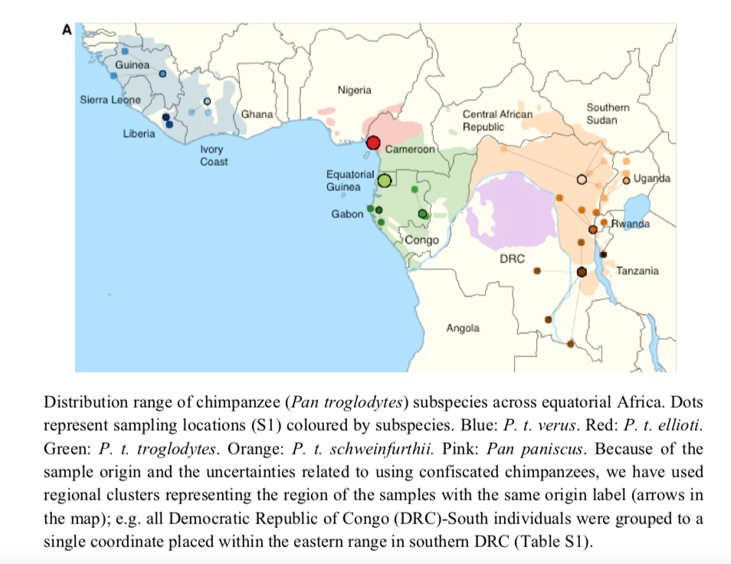
Pan paniscus = bonobos; Pan troglodyte = chimpanzees

